Slide 1
Process Activities

Slide 2
Implementation

Slide 3
Introduction
The implementation phase is the process of converting a system specification into an executable system.
If an incremental approach is used, it may also involve refinement of the software specification.
Programmers carry out some program testing to discover faults in the program and remove these faults in the debugging process.

Slide 4
Coding Style
They way you write your code.
It is all about consistency and make your code readable for others.
Certain rules are follow to make your code style good.

Slide 5
Good Coding Style
Elements of Good Coding Style,
Naming convention
File names
Indentation
Placement of braces
Use of whitespace

Slide 6
Naming convention
Variable vs routine
variable_name, routineName(), RoutineName()
Class vs object
Widge, my_widget
Member variables
_variable or variable_

Slide 7
File name
Common to use _ or – between words, don’t use space.
Windows allow space between words but not in Linux or MAC.
Even extension could need specification.
Linked-list.cpp, Linked_list.cpp, linkedlist.cpp
Linked list.cpp

Slide 8
Indentation
A timeless battle: tabs versus spaces
Important is indent to show nesting level and be consistent.
class Test class Test class Test
{ { {
int a; int a; int a;
void func(int a) void func(int a) void func(int a)
{ { {
print(a) print(a); print(a);
} } }
} } }

Slide 9
Placement of Braces
1. K&R
void CheckNeg(int x)
{
if (x<0){
negative(x)
} else
nonnegative(x)
}
1. 1TBS
void CheckNeg(int x){
if (x<0){
negative(x)
} else {
nonnegative(x)
}
}
1. Allman
void CheckNeg(int x)
{
if (x<0)
{
negative(x)
}
else
{
nonnegative(x)
}
}

Slide 10
Use of white spaces
Can make a real difference in understanding,
double *a;
double* a;
double * a;
Example of understanding difficulty,
double* a,b; VS double *a,b;

Slide 11
Examples

Slide 12
Example 1:
X = 3+4 * 7+5;

Slide 13
Example 1:
X = 3+4 * 7+5;
Seems like,
3+4= 7
7+5 = 12
7*12 =84
X=84
Actually,
4*7 = 28
3+28=31
31+5 =36
X=36

Slide 14
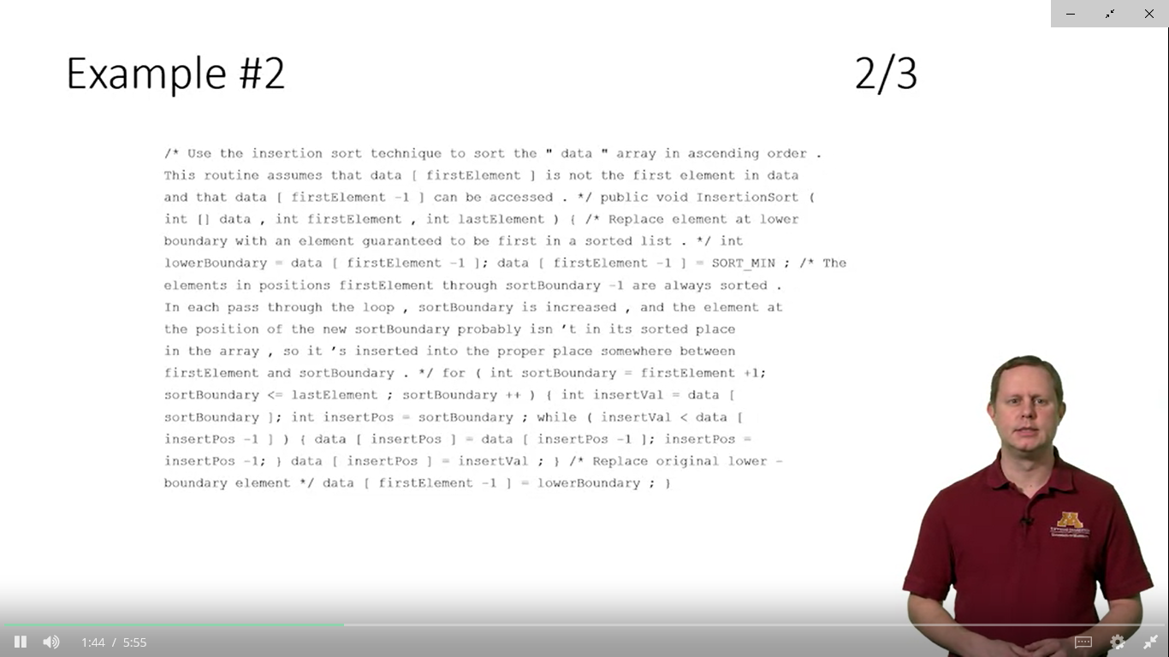

Slide 15
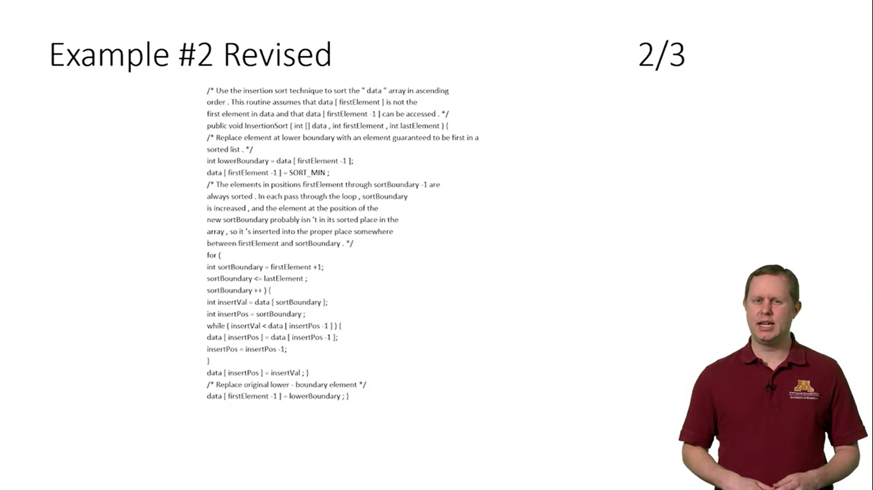

Slide 16
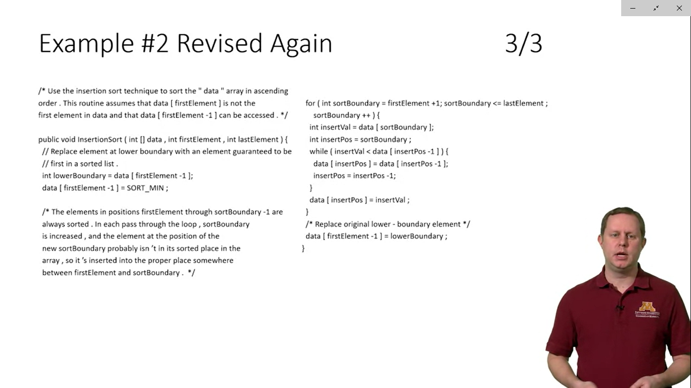

Slide 17
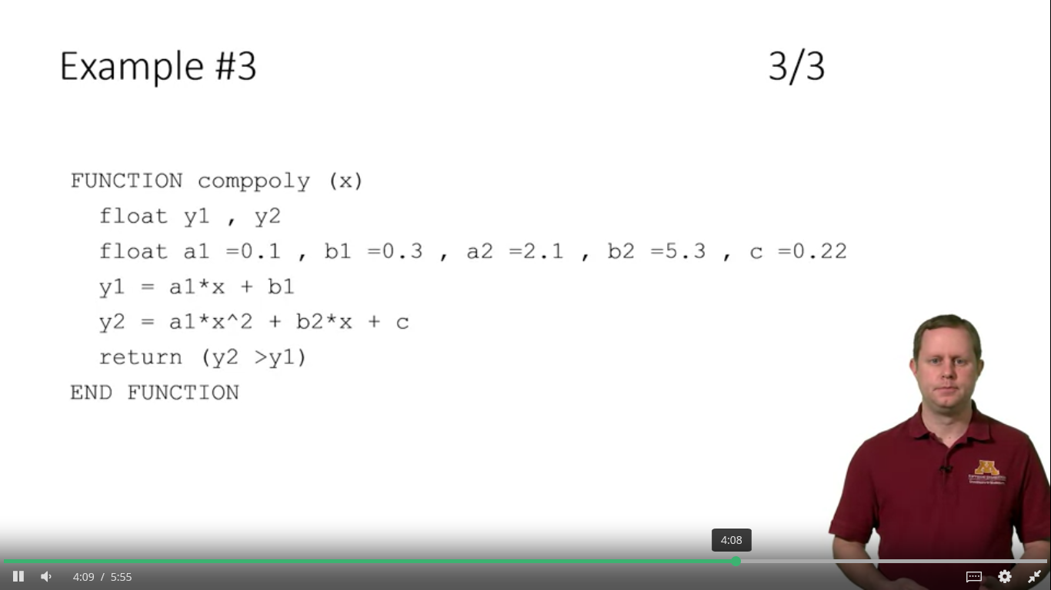

Slide 18
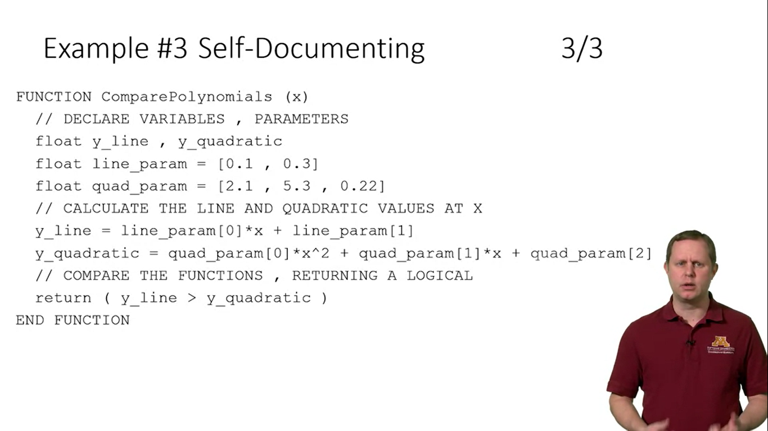

Slide 19
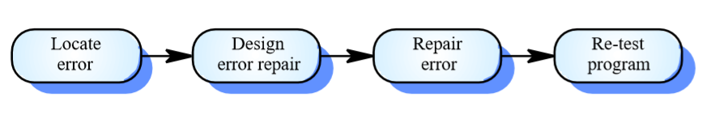
Debugging
The art of removing defects.
Two forms:
Print statements
Debugging tools
Error Messages: Its difficult to read error messages prompt by
compiler.

Slide 20
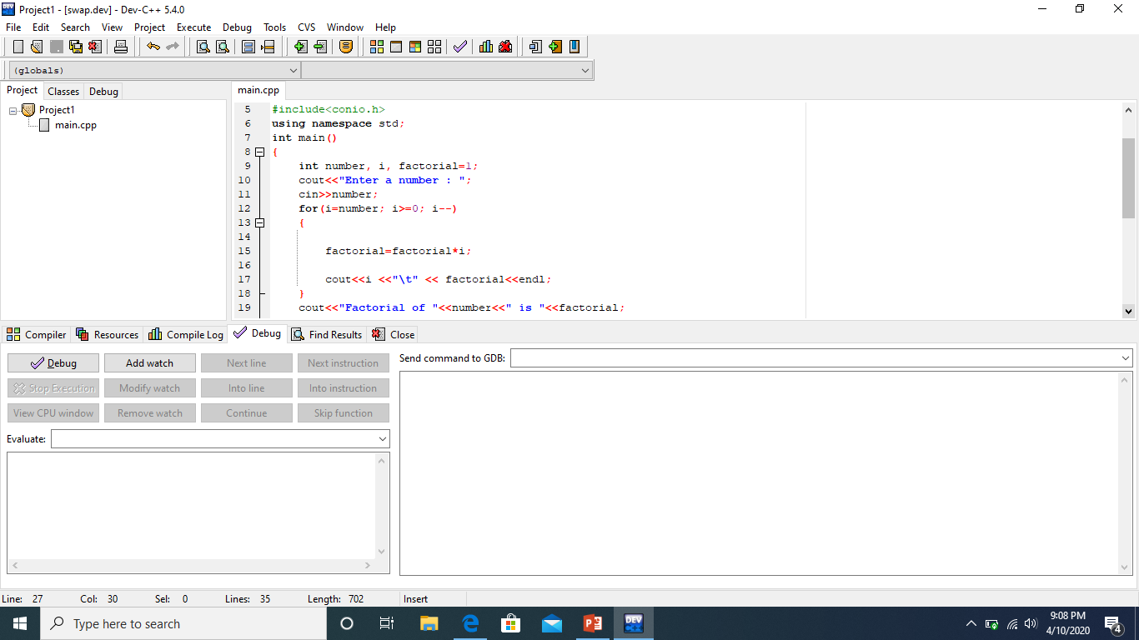
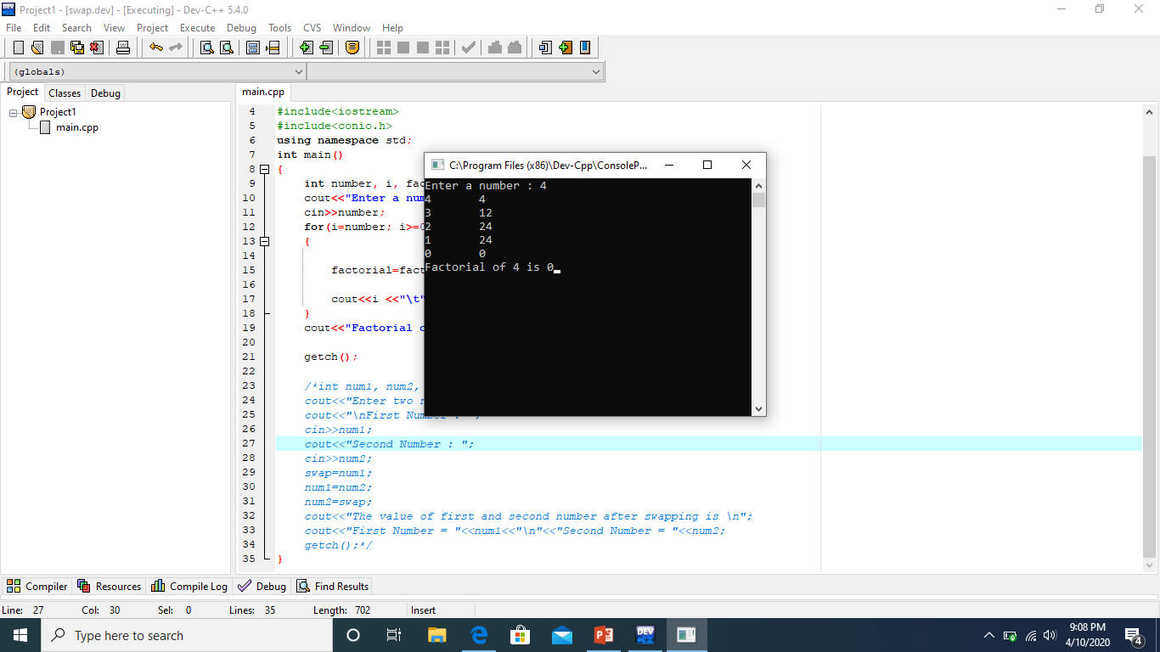
Example (Print Statement)

Slide 21
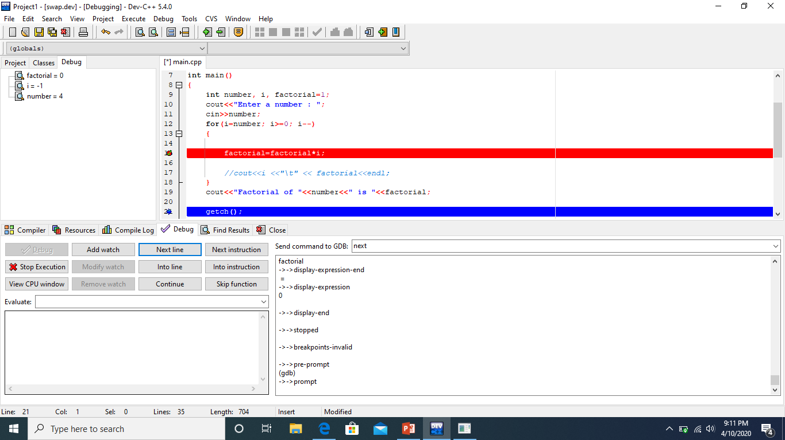
Example Debugging

Slide 22
In-code Documentation
Comment
Self-Documenting Code

Slide 23
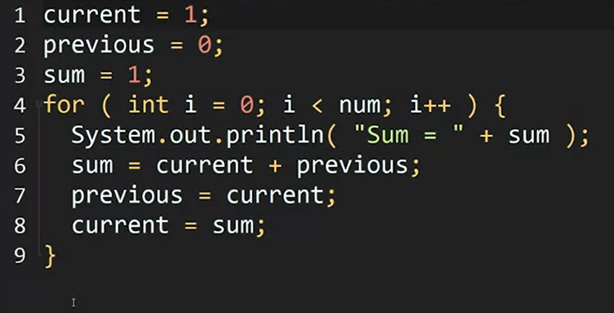
Example 1

Slide 24
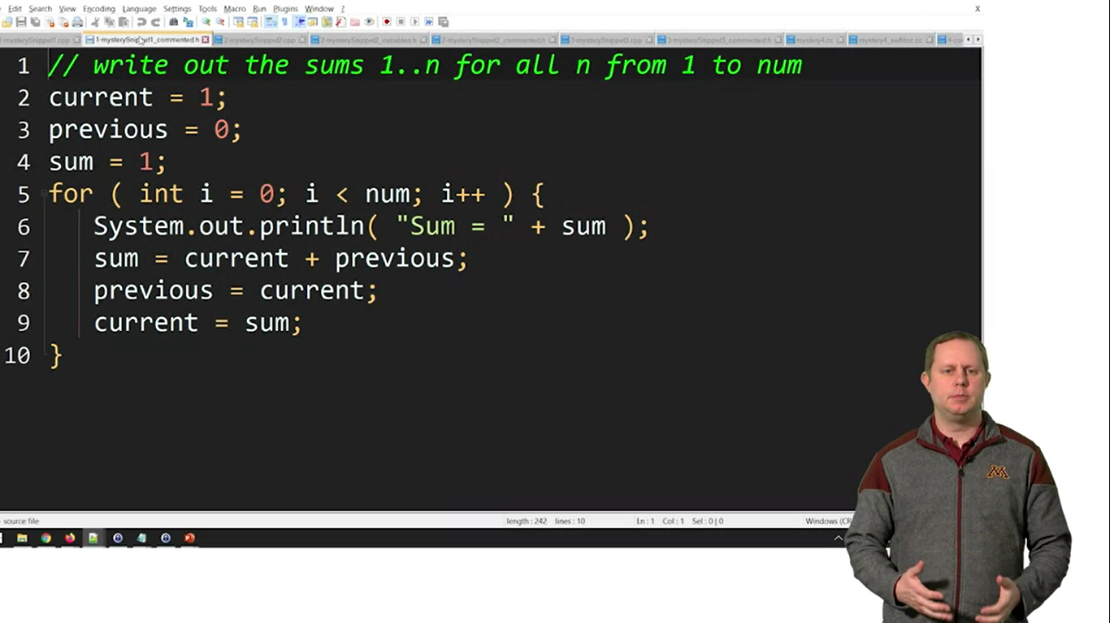
Example 1 (Comment)

Slide 25
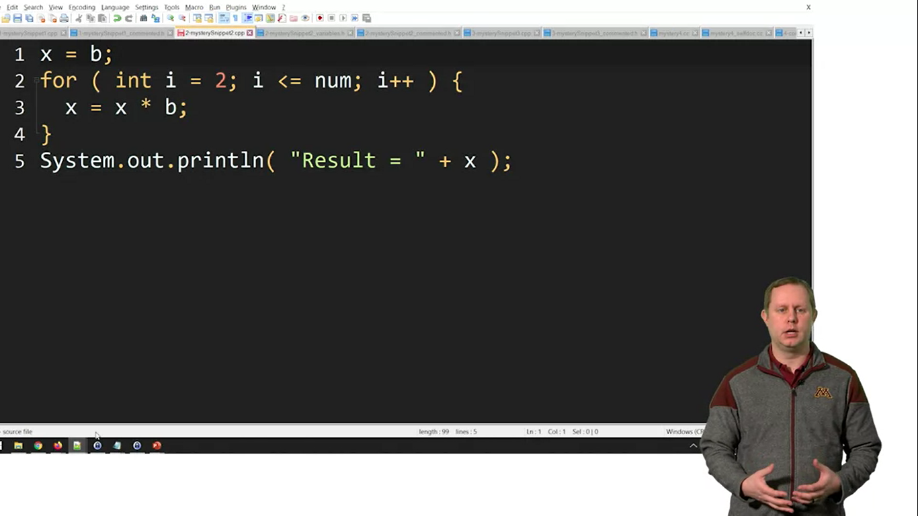
Example 2

Slide 26

Example 2 (Self Documenting Code)

Slide 27
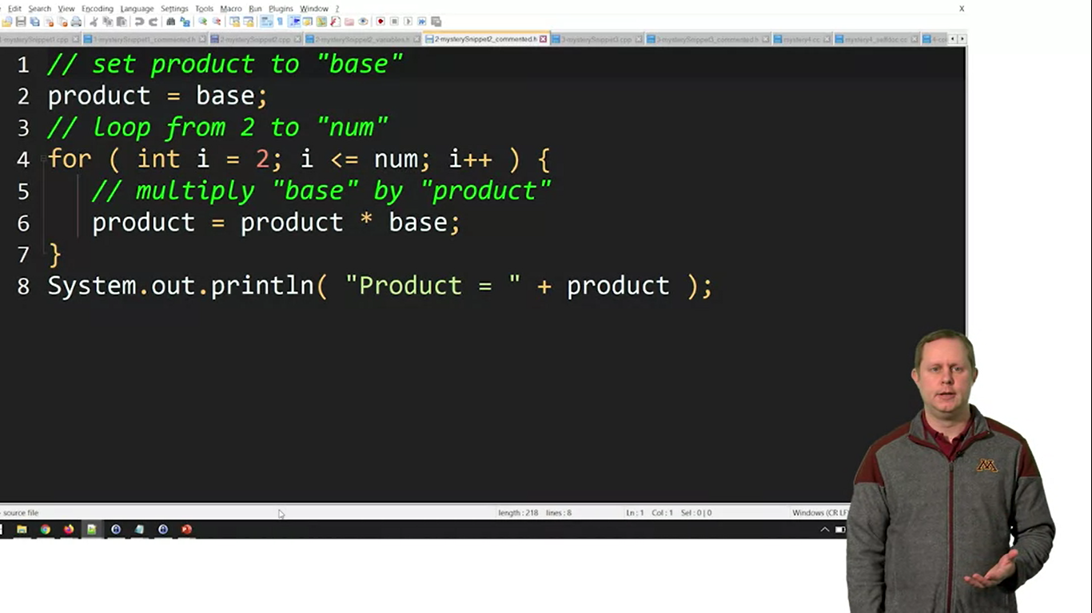
Example 3: Bad comments

Slide 28
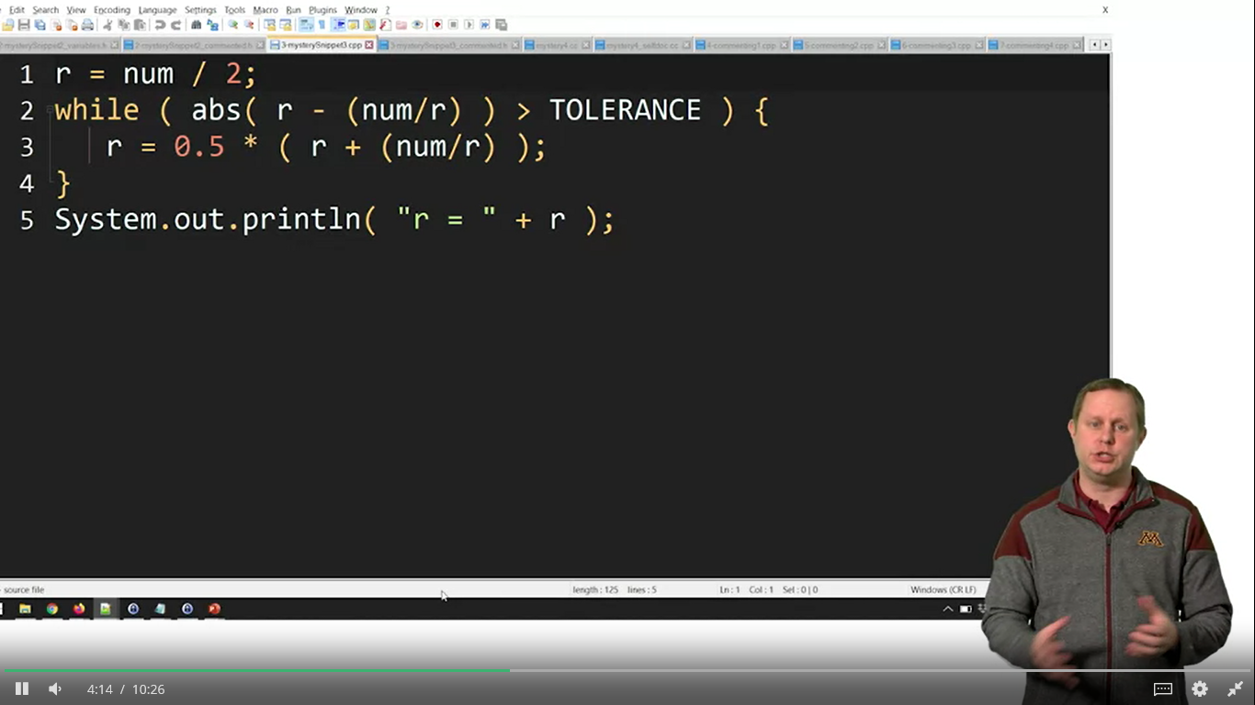
Example 4

Slide 29
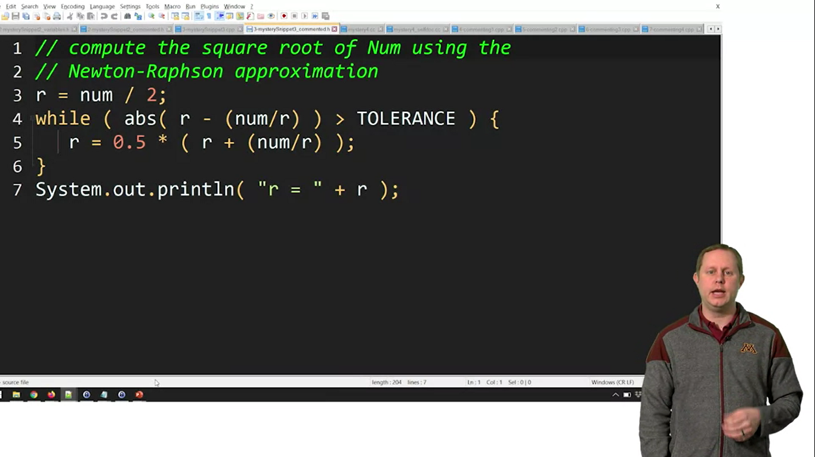
Example 4: One line Comment

Slide 30
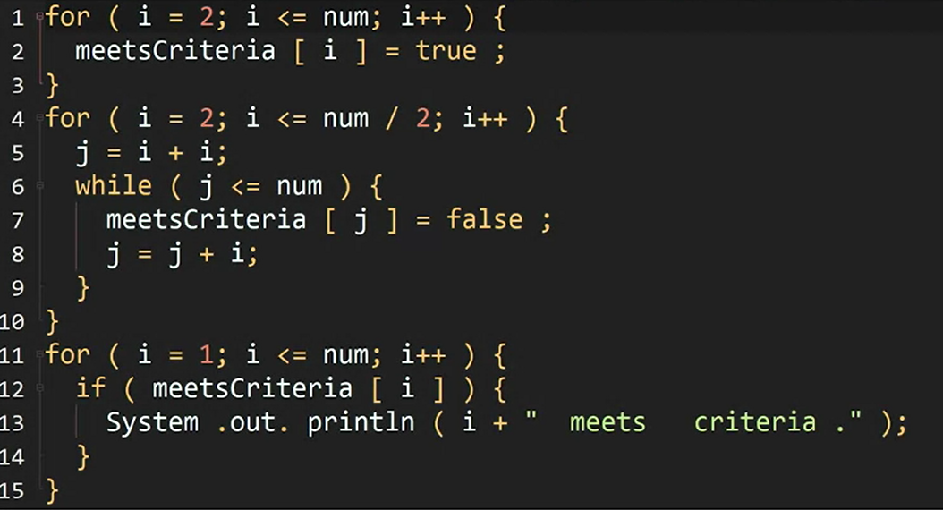
Example 5

Slide 31
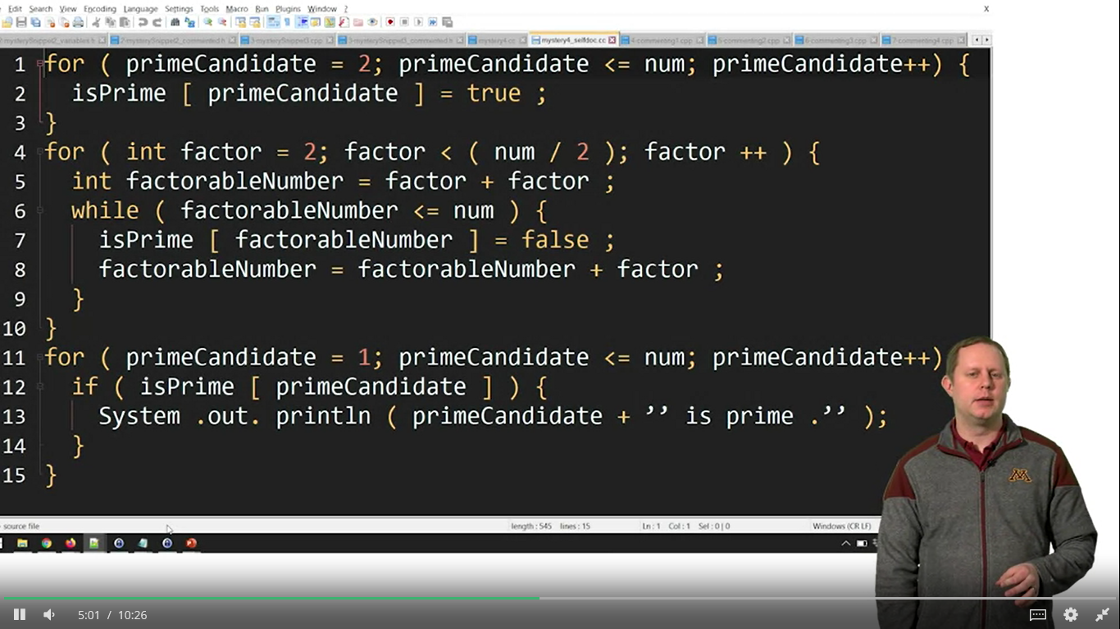
Example 5 : Self Documenting Code

Slide 32
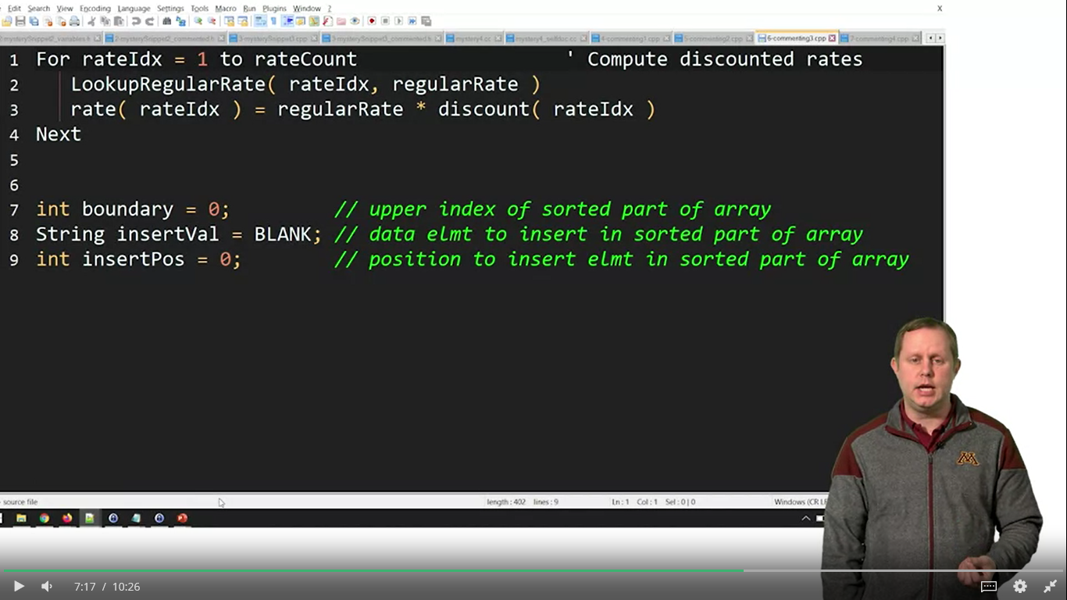
Example 6: In line comment

Slide 33
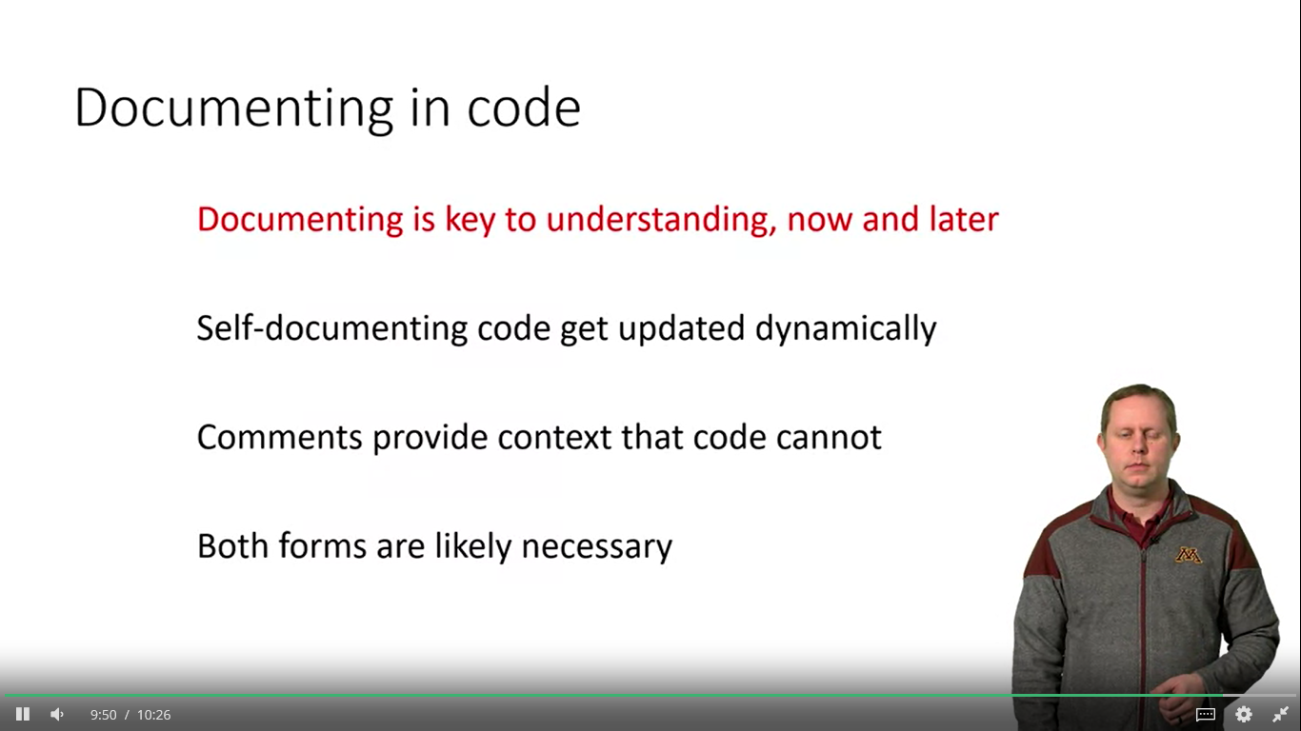

Slide 34
Software Industry – Code Implementation Best Practices
Commenting & Documentation properly with in the code.
Consistent Indentation styles are not always completely distinct from one another. Sometimes, they mix different rules. For example, in PEAR Coding Standards.
Avoid Obvious Comments means When the text is that obvious, it's really not productive to repeat it within comments.
Always following the Code Grouping certain tasks require a few lines of code then It is a good idea to keep these tasks within separate blocks of code, with some spaces between them.
Always used Consistent Naming Scheme and it should be word boundaries either Pascal Case or Camel Case.
Always follow the DRY Principle that is Don't Repeat Yourself, also known as DIE: Duplication is Evil

Slide 35
Software Industry – Code Implementation Best Practices
Always Avoid Deep Nesting within your code because too many levels of nesting can make code harder to read and follow.
It is good practice that follow the Limit Line Length concept to avoid writing horizontally long lines of code.
File and Folder Organization is the best approaches is to either use a framework or manage project folder structure.
Always capitalize SQL Special Words and functions capitalize them to distinguish them from your table and column names.
Always use Separation of Code and Data because things have changed over the years and websites became more and more dynamic and functional.
Continuously do Code Refactoring so that we can make changes to the code without changing any of its functionality therefore it is a "clean up" process for the sake of improving readability and quality

